Slide 1
Support Vector Machine

Slide 2
Outline
Hinge Loss
Support Vector Machine (SVM)
Kernel Method

Slide 3
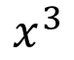
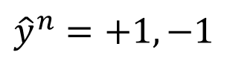
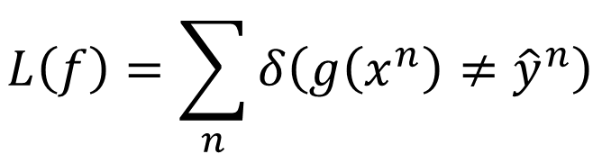
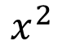
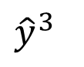
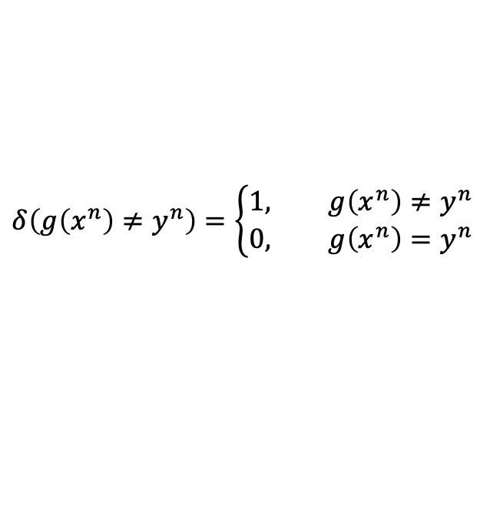
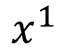
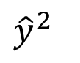
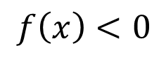
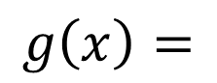
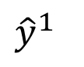
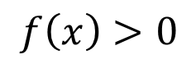

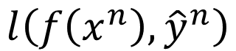
Binary Classification
$$x^{1}$$
$$x^{2}$$
$$x^{3}$$
$$……$$
$${\hat{y}}^{1}$$
$${\hat{y}}^{2}$$
$${\hat{y}}^{3}$$
$${\hat{y}}^{n}=+1,−1$$
Step 1: Function set (Model)
Step 2: Loss function:
Step 3: Training by gradient descent is difficult
$$f\left(x\right)>0$$
Output = +1
$$g\left(x\right)=$$
$$f\left(x\right)<0$$
Output = -1
$$L\left(f\right)=\sum_{n}{δ\left(g\left(x^{n}\right)≠{\hat{y}}^{n}\right)}$$
The number of times g get incorrect results on training data.
$$l\left(f\left(x^{n}\right),{\hat{y}}^{n}\right)$$
$$δ\left(g\left(x^{n}\right)≠y^{n}\right)=\left\{\begin{aligned}1, g\left(x^{n}\right)≠y^{n} \\ &0, g\left(x^{n}\right)=y^{n}\end{aligned}\right.$$
Notes:
Step 1: Function set (Model) 的本质是两个向量相乘
两个向量分别是参数 W 和 输入 X
两个向量相乘的结果的正负与两个向量之间的夹角有关
The number of times g get incorrect results on training data. g在训练数据上得到错误结果的次数。

Slide 4
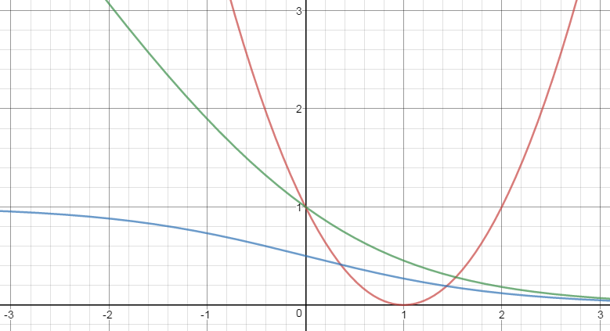
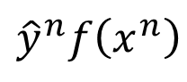
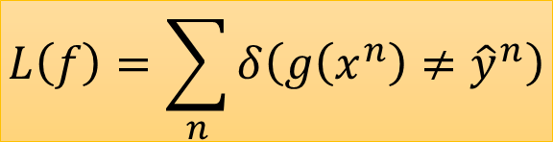
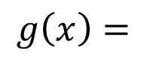
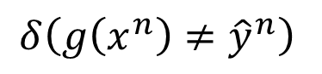
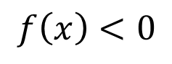
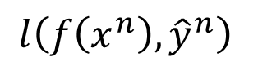
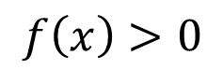
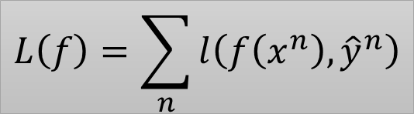
Step 2: Loss function
$$f\left(x\right)>0$$
Output = +1
$$g\left(x\right)=$$
$$f\left(x\right)<0$$
Output = -1
Ideal loss:
Approximation:
$$L\left(f\right)=\sum_{n}{δ\left(g\left(x^{n}\right)≠{\hat{y}}^{n}\right)}$$
$$L\left(f\right)=\sum_{n}{l\left(f\left(x^{n}\right),{\hat{y}}^{n}\right)}$$
$$l\left(f\left(x^{n}\right),{\hat{y}}^{n}\right)$$
Ideal loss
$$δ\left(g\left(x^{n}\right)≠{\hat{y}}^{n}\right)$$
Larger value, smaller loss
$${\hat{y}}^{n}f\left(x^{n}\right)$$
Notes:
Approximation 近似

Slide 5
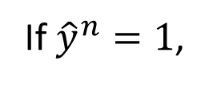
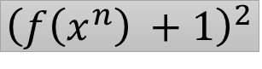
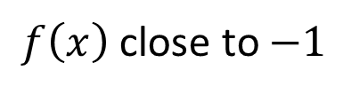
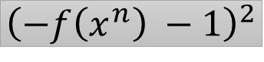
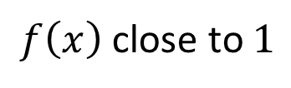
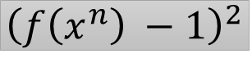
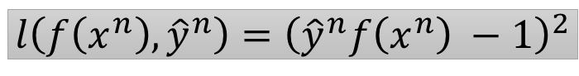
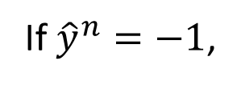
Step 2: Loss function
If ${\hat{y}}^{n}=1$,
$f\left(x\right)$close to $1$
Square Loss:
If ${\hat{y}}^{n}=−1$,
$f\left(x\right)$close to $−1$
$${\left(f\left(x^{n}\right) −1\right)}^{2}$$
$$l\left(f\left(x^{n}\right),{\hat{y}}^{n}\right)={\left({\hat{y}}^{n}f\left(x^{n}\right) −1\right)}^{2}$$
$${\left(−f\left(x^{n}\right) −1\right)}^{2}$$
$${\left(f\left(x^{n}\right) +1\right)}^{2}$$
$$l\left(f\left(x^{n}\right),{\hat{y}}^{n}\right)$$
Square loss
不合理 …
Ideal loss
Larger value, smaller loss
$${\hat{y}}^{n}f\left(x^{n}\right)$$

Slide 6
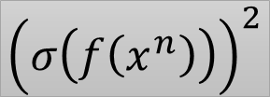
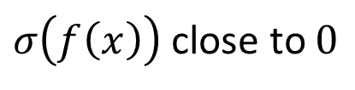
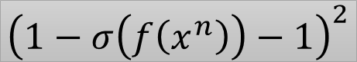
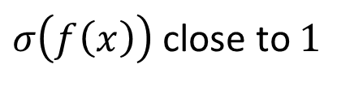
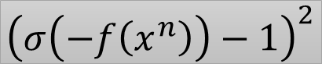

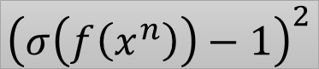
Step 2: Loss function
If ${\hat{y}}^{n}=1$,
$σ\left(f\left(x\right)\right)$ close to $1$
Sigmoid + Square Loss:
If ${\hat{y}}^{n}=−1$,
$σ\left(f\left(x\right)\right)$ close to $0$
$${\left(σ\left(f\left(x^{n}\right)\right)−1\right)}^{2}$$
$$l\left(f\left(x^{n}\right),{\hat{y}}^{n}\right)={\left(σ\left({\hat{y}}^{n}f\left(x^{n}\right)\right)−1\right)}^{2}$$
$${\left(σ\left(−f\left(x^{n}\right)\right)−1\right)}^{2}$$
$${\left(1−σ\left(f\left(x^{n}\right)\right)−1\right)}^{2}$$
$${\left(σ\left(f\left(x^{n}\right)\right)\right)}^{2}$$
Square loss
Ideal loss
Sigmoid + Square loss
Larger value, smaller loss
$${\hat{y}}^{n}f\left(x^{n}\right)$$

Slide 7
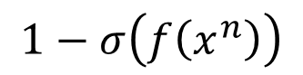
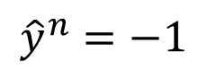
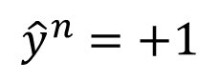
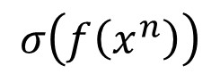
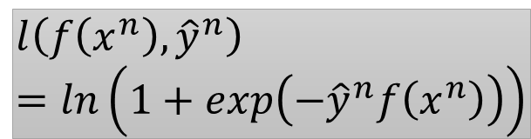
Step 2: Loss function
Sigmoid + cross entropy
(logistic regression)
$${\hat{y}}^{n}=+1$$
$$σ\left(f\left(x^{n}\right)\right)$$
Ground
Truth
cross entropy
1.0
$${\hat{y}}^{n}=−1$$
$$1−σ\left(f\left(x^{n}\right)\right)$$
努力可以
有回報
$$l\left(f\left(x^{n}\right),{\hat{y}}^{n}\right)=ln\left(1+exp\left(−{\hat{y}}^{n}f\left(x^{n}\right)\right)\right)$$
Sigmoid + cross entropy
Square loss
Ideal loss
Sigmoid + Square loss
Divided by ln2 here
沒有回報
不想努力
Larger value, smaller loss
$${\hat{y}}^{n}f\left(x^{n}\right)$$

Slide 8

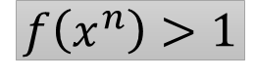


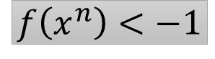
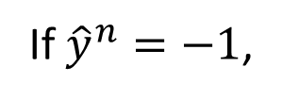
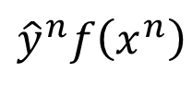
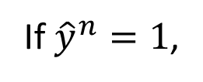

Step 2: Loss function
$$l\left(f\left(x^{n}\right),{\hat{y}}^{n}\right)=max\left(0,1−{\hat{y}}^{n}f\left(x^{n}\right)\right)$$
If ${\hat{y}}^{n}=1$,
$$max\left(0,1−f\left(x^{n}\right)\right)$$
$$1−f\left(x^{n}\right)<0$$
$$f\left(x^{n}\right)>1$$
If ${\hat{y}}^{n}=−1$,
$$max\left(0,1+f\left(x^{n}\right)\right)$$
$$1+f\left(x^{n}\right)<0$$
$$f\left(x^{n}\right)<−1$$
Hinge Loss
及格就好
Sigmoid + cross entropy
Square loss
好還要更好
Ideal loss
Sigmoid + Square loss
$${\hat{y}}^{n}f\left(x^{n}\right)$$
Larger value, smaller loss
penalty
Good enough
Notes:
penalty
因违反法律、规定或合同而受到的)处罚, 刑罚;
(行为、环境带来的)不利后果, 苦难;
(体育运动中对犯规者的)判罚, 处罚;
(足球、橄榄球及类似运动中的)罚球;
(桥牌)(叫牌者未完成定约时的)罚分

Slide 9
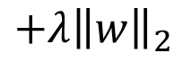
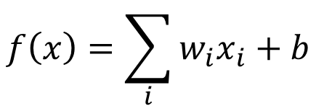
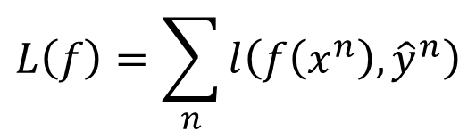
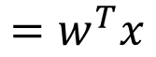

Linear SVM
Compared with logistic regression, linear SVM has different loss function
Deep version:
Yichuan Tang , “Deep Learning using Linear Support Vector Machines”, ICML 2013 Challenges in Representation Learning Workshop
Step 1: Function (Model)
Step 2: Loss function
Step 3: gradient descent?
New w
$$f\left(x\right)=\sum_{i}{w_{i}x_{i}}+b$$
$$=\left[\begin{aligned}w \\ b\end{aligned}\right]∙\left[\begin{aligned}x \\ 1\end{aligned}\right]$$
$$=w^{T}x$$
New x
$$L\left(f\right)=\sum_{n}{l\left(f\left(x^{n}\right),{\hat{y}}^{n}\right)}$$
$$+λ{\left\|w\right\|}_{2}$$
convex
$$l\left(f\left(x^{n}\right),{\hat{y}}^{n}\right)=max\left(0,1−{\hat{y}}^{n}f\left(x^{n}\right)\right)$$
Recall relu, maxout network
Shai Shalev-Shwartz, Yoram Singer, Nathan Srebro, “Pegasos: Primal Estimated sub-GrAdient SOlver for SVM“, ICML, 2007
Notes:
convex 凸

Slide 10












Linear SVM – gradient descent
Ignore regularization for simplicity
$$L\left(f\right)=\sum_{n}{l\left(f\left(x^{n}\right),{\hat{y}}^{n}\right)}$$
$$l\left(f\left(x^{n}\right),{\hat{y}}^{n}\right)=max\left(0,1−{\hat{y}}^{n}f\left(x^{n}\right)\right)$$
$$\frac{∂l\left(f\left(x^{n}\right),{\hat{y}}^{n}\right)}{∂w_{i}}=\frac{∂l\left(f\left(x^{n}\right),{\hat{y}}^{n}\right)}{∂f\left(x^{n}\right)}\frac{∂f\left(x^{n}\right)}{∂w_{i}}$$
$$f\left(x^{n}\right)$$
$$=w^{T}∙x^{n}$$
$$x_{i}^{n}$$
$$\frac{∂max\left(0,1−{\hat{y}}^{n}f\left(x^{n}\right)\right)}{∂f\left(x^{n}\right)}=$$
$$−{\hat{y}}^{n}$$
If ${\hat{y}}^{n}f\left(x^{n}\right)<1$
$$1−{\hat{y}}^{n}f\left(x^{n}\right)>0$$
$$0$$
otherwise
$$\frac{∂L\left(f\right)}{∂w_{i}}=\sum_{n}{−δ\left({\hat{y}}^{n}f\left(x^{n}\right)<1\right){\hat{y}}^{n}x_{i}^{n}}$$
$$w_{i}←w_{i}−η\sum_{n}{c^{n}\left(w\right)x_{i}^{n} }$$
$$c^{n}\left(w\right)$$

Slide 11








Linear SVM – another formulation
Minimizing loss function L:
$$L\left(f\right)=\sum_{n}{l\left(f\left(x^{n}\right),{\hat{y}}^{n}\right)}$$
$$ε^{n}$$
$$+λ{\left\|w\right\|}_{2}$$
$ε^{n}$: slack variable
$$ε^{n}=max\left(0,1−{\hat{y}}^{n}f\left(x^{n}\right)\right)$$
Quadratic Programming (QP) Problem
=
$$ε^{n}≥0$$
$$ε^{n}≥1−{\hat{y}}^{n}f\left(x^{n}\right)$$
$${\hat{y}}^{n}f\left(x^{n}\right)≥1−ε^{n}$$
Notes:
another formulation 另一种表述
Quadratic Programming (QP) Problem 二次规划（QP）问题

Slide 12


Slide 13


Slide 14


Slide 15


Slide 16




Slide 17


拉格朗日乘子法

Slide 18
Outline
Hinge Loss
Support Vector Machine (SVM)
Kernel Method

Slide 19









Dual Representation
$$w^{∗}=\sum_{n}{α_{n}^{∗}x^{n}}$$
Linear combination of data points
$α_{n}^{∗}$ may be sparse
$x_{}^{n}$ with non-zero $α_{n}^{∗}$ are support vectors
If w initialized as 0
$$w_{1}←w_{1}−η\sum_{n}{c^{n}\left(w\right)x_{1}^{n} }$$
$$w←w−η\sum_{n}{c^{n}\left(w\right)x^{n}}$$
……
$$w_{i}←w_{i}−η\sum_{n}{c^{n}\left(w\right)x_{i}^{n} }$$
$$c^{n}\left(w\right)$$
$$=\frac{∂l\left(f\left(x^{n}\right),{\hat{y}}^{n}\right)}{∂f\left(x^{n}\right)}$$
Hinge loss: usually zero
……
$$w_{k}←w_{k}−η\sum_{n}{c^{n}\left(w\right)x_{k}^{n} }$$
c.f. for logistic regression, it is always non-zero
Notes:
Dual Representation 二元表示
用拉格朗日乘子法解出来之后，可以知道 W 的最小值是 Linear combination of data points

Slide 20


















Dual Representation
$$α=\left[\begin{aligned}α_{1} \\ α_{2} \\ ⋮ \\ α_{N}\end{aligned}\right]$$
$$w=\sum_{n}{α_{n}^{}x^{n}}$$
$$x^{1}$$
$$x^{2}$$
$$x^{N}$$
$$=Xα$$
$$X=$$
……
$$w=Xα$$
Step 1:
$$f\left(x\right)=w^{T}x$$
$$f\left(x\right)=α^{T}X^{T}x$$
$$\left[\begin{matrix}α_{1} & ⋯ & α_{N}\end{matrix}\right]$$
$$x$$
$$f\left(x\right)=\sum_{n}{α_{n}\left(x^{n}∙x\right)}$$
$$x^{1}$$
$$x^{2}$$
$$\left[\begin{aligned}x^{1}∙x \\ x^{2}∙x \\ ⋮ \\ x^{N}∙x\end{aligned}\right]$$
……
$$=\sum_{n}{α_{n}K\left(x^{n},x\right)}$$
$$x^{N}$$
Notes:
$α_{n}$ is the unknown parameters to be found

Slide 21





Dual Representation
Step 1:
$$f\left(x\right)=\sum_{n}{α_{n}K\left(x^{n},x\right)}$$
Step 2, 3:
Find $\left\{α_{1}^{∗},⋯,α_{n}^{∗},⋯,α_{N}^{∗}\right\}$,
minimizing loss function L
We don’t really need to know vector x
$$L\left(f\right)=\sum_{n}{l\left(f\left(x^{n}\right),{\hat{y}}^{n}\right)}$$
We only need to know the inner project between a pair of vectors x and z
$$=\sum_{n}{l\left(\sum_{n^{′}}{α_{n^{′}}K\left(x^{n^{′}},x^{n}\right)},{\hat{y}}^{n}\right)}$$
$$K\left(x,z\right)$$
Kernel Trick

Slide 22










Kernel Trick
Directly computing $K\left(x,z\right)$ can be faster than “feature transformation + inner product” sometimes.
Kernel trick is useful when we transform all x to $φ\left(x\right)$
$$=\left[\begin{aligned}{x_{1}}^{2} \\ {\sqrt{2}x_{1}x}_{2} \\ {x_{2}}^{2}\end{aligned}\right]∙\left[\begin{aligned}{z_{1}}^{2} \\ {\sqrt{2}z_{1}z}_{2} \\ {z_{2}}^{2}\end{aligned}\right]$$
$$K\left(x,z\right)=$$
$$φ\left(x\right)∙φ\left(z\right)$$
$$x=\left[\begin{aligned}x_{1} \\ x_{2}\end{aligned}\right]$$
$$={x_{1}}^{2}{z_{1}}^{2}+2{x_{1}x}_{2}{z_{1}z}_{2}+{x_{2}}^{2}{z_{2}}^{2}$$
$$φ\left(x\right)=\left[\begin{aligned}{x_{1}}^{2} \\ {\sqrt{2}x_{1}x}_{2} \\ {x_{2}}^{2}\end{aligned}\right]$$
$$={\left(\left[\begin{aligned}x_{1} \\ x_{2}\end{aligned}\right]∙\left[\begin{aligned}z_{1} \\ z_{2}\end{aligned}\right]\right)}^{2}$$
$$={\left(x_{1}z_{1}+x_{2}z_{2}\right)}^{2}$$
$$={\left(x∙z\right)}^{2}$$

Slide 23









Kernel Trick
Directly computing $K\left(x,z\right)$ can be faster than “feature transformation + inner product” sometimes.
$$x=\left[\begin{aligned}x_{1} \\ ⋮ \\ x_{k}\end{aligned}\right]$$
$$z=\left[\begin{aligned}z_{1} \\ ⋮ \\ z_{k}\end{aligned}\right]$$
$$K\left(x,z\right)$$
$$={\left(x∙z\right)}^{2}$$
$$={\left(x_{1}z_{1}+x_{2}z_{2}+⋯+x_{k}z_{k}\right)}^{2}$$
$$φ\left(x\right)=\left[\begin{aligned}{x_{1}}^{2} \\ ⋮ \\ {x_{k}}^{2} \\ \sqrt{2}x_{1}x_{2} \\ \sqrt{2}x_{1}x_{3} \\ ⋮ \\ \sqrt{2}x_{2}x_{3} \\ ⋮\end{aligned}\right]$$
$$={x_{1}}^{2}{z_{1}}^{2}+{x_{2}}^{2}{z_{2}}^{2}+⋯+{x_{k}}^{2}{z_{k}}^{2}$$
$$+2x_{1}x_{2}z_{1}z_{2}+2x_{1}x_{3}z_{1}z_{3}+⋯$$
$$+2x_{2}x_{3}z_{2}z_{3}+2x_{2}x_{4}z_{2}z_{4}+⋯$$
$$=φ\left(x\right)∙φ\left(z\right)$$

Slide 24














Radial Basis Function Kernel
$$x=\left[\begin{aligned}x_{1} \\ x_{2} \\ ⋮\end{aligned}\right]$$
$$z=\left[\begin{aligned}z_{1} \\ z_{2} \\ ⋮\end{aligned}\right]$$
$$=exp\left(−\frac{1}{2}{\left\|x−z\right\|}_{2}\right)$$
$$K\left(x,z\right)$$
$$=φ\left(x\right)∙φ\left(z\right)?$$
$$=exp\left(−\frac{1}{2}{\left\|x\right\|}_{2}−\frac{1}{2}{\left\|z\right\|}_{2}+x∙z\right)$$
$φ\left(∗\right)$ has inf dim!!!
$$=exp\left(−\frac{1}{2}{\left\|x\right\|}_{2}\right)exp\left(−\frac{1}{2}{\left\|z\right\|}_{2}\right)exp\left(x∙z\right)$$
$$=C_{x}C_{z}exp\left(x∙z\right)$$
$$=C_{x}C_{z}\sum_{i=0}^{∞}{\frac{{\left(x∙z\right)}^{i}}{i!}}$$
$$=C_{x}C_{z}+C_{x}C_{z}\left(x∙z\right)+C_{x}C_{z}\frac{1}{2}{\left(x∙z\right)}^{2}⋯$$
$$\frac{1}{\sqrt{2}}\left[\begin{aligned}C_{x}{x_{1}}^{2} \\ ⋮ \\ \sqrt{2}C_{x}x_{1}x_{2} \\ ⋮\end{aligned}\right]∙\frac{1}{\sqrt{2}}\left[\begin{aligned}C_{z}{z_{1}}^{2} \\ ⋮ \\ \sqrt{2}C_{z}z_{1}z_{2} \\ ⋮\end{aligned}\right]$$
$$\left[\begin{aligned}C_{x}x_{1} \\ C_{x}x_{2} \\ ⋮\end{aligned}\right]∙\left[\begin{aligned}C_{z}z_{1} \\ C_{z}z_{2} \\ ⋮\end{aligned}\right]$$
$$\left[C_{x}\right]∙\left[C_{z}\right]$$

Slide 25










Sigmoid Kernel
$$K\left(x,z\right)=tanh\left(x∙z\right)$$
When using sigmoid kernel, we have a 1 hidden layer network.
$$f\left(x\right)=\sum_{n}{α_{n}K\left(x^{n},x\right)}$$
$$=\sum_{n}{α_{n}tanh\left(x^{n}∙x\right)}$$
$$x^{1}$$
The weight of each neuron is a data point
$$α_{1}$$
x
$$x^{2}$$
$$α_{2}$$
$$f\left(x\right)$$
The number of support vectors is the number of neurons.
$$x^{n}$$
……
$$α_{n}$$

Slide 26




You can directly design $K\left(x,z\right)$ instead of considering $φ\left(x\right),φ\left(z\right)$
When x is structured object like sequence,
hard to design $φ\left(x\right)$
$K\left(x,z\right)$ is something like similarity
(Mercer’s theory can check)
Evaluate the similarity between sequences as $K\left(x,z\right)$
Audio Segment
More about kernel design in [Bishop chapter 6.2]
Audio Segment
Hiroshi Shimodaira, Ken-ichi Noma, Mitsuru Nakai, Shigeki Sagayama, “Dynamic Time-Alignment Kernel in Support Vector Machine”, NIPS, 2002
Marco Cuturi, Jean-Philippe Vert, Oystein Birkenes, Tomoko Matsui, A kernel for time series based on global alignments, ICASSP, 2007

Slide 27
SVM related methods
Support Vector Regression (SVR)
[Bishop chapter 7.1.4]
Ranking SVM
[Alpaydin, Chapter 13.11]
One-class SVM
[Alpaydin, Chapter 13.11]

Slide 28




Deep Learning
Feature transformation
linear classifier
$$φ\left(x\right)$$
……
y₁
$$x$$
……
y₂
…
…
…
…
…
……
y_{M}
SVM
Based on kernel function
$$φ\left(x\right)$$
linear classifier
Multiple Kernel learning [Alpaydin, Chapter 13.8]
Notes:
Source of image: http://www.gipsa-lab.grenoble-inp.fr/transfert/seminaire/455_Kadri2013Gipsa-lab.pdf

Slide 29
参考
Support Vector Machines Part 1 (of 3): Main Ideas!!!
https://www.youtube.com/watch?v=efR1C6CvhmE

